Slide 1
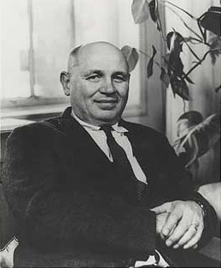
Romare Bearden
1911-1988

Slide 2
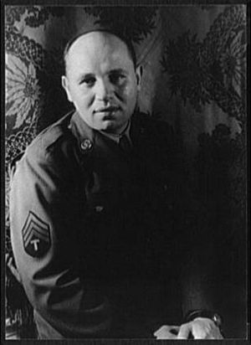
“What gave these collages special power was their size. Originally they were no larger than 14 by 18 inches, but striving for monumentality, Bearden had them photographed and blown up to large black and white sheets, which he named 'Projections.' Their size was typically six by eight feet or four by five feet. . . Reviewers hailed them as 'startling,' 'emphatic,' 'moving,' 'memorable' and 'propagandistic in the best sense.”
-Michael Brenson

Slide 3
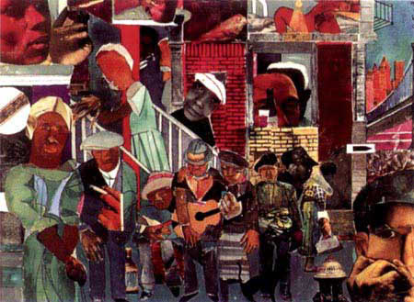

Slide 4
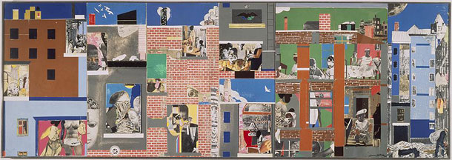
Romare Bearden
The Block II
1972

Slide 5
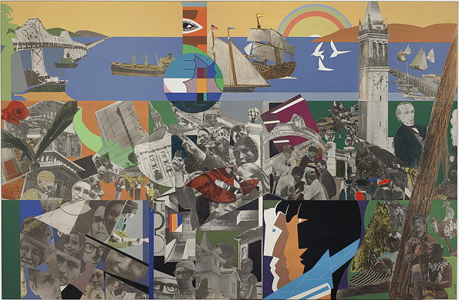
Romare Bearden
Berkeley––The City and Its People
1973

Slide 6
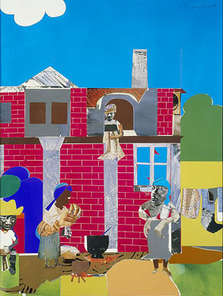
Romare Bearden
Monday Morning
1967

Slide 7
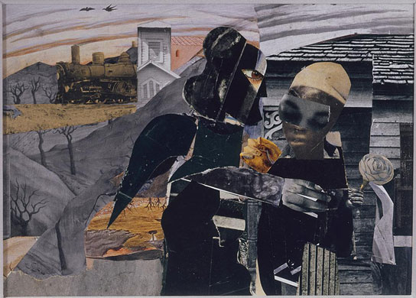
Romare Bearden
Prevalence of Ritual: Tidings
1964

Slide 8
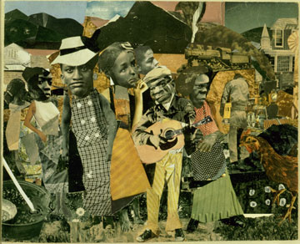

Slide 9
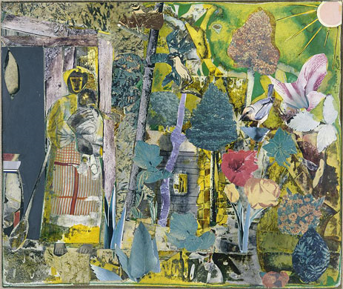
Romare Bearden
Madeline Jones’ Wonderful Garden 1
1977

Slide 10
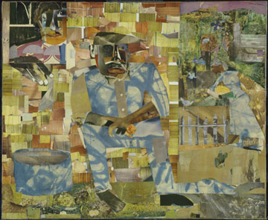
Romare Bearden
Tomorrow I May Be Far Away 1966/1967

Slide 11
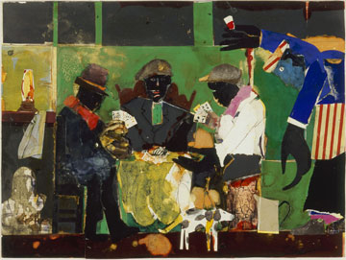
Romare Bearden
Card Players
1982

Slide 12
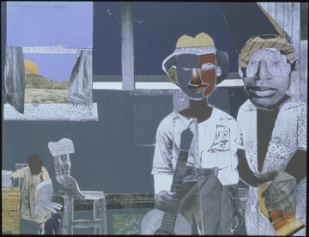

Slide 13
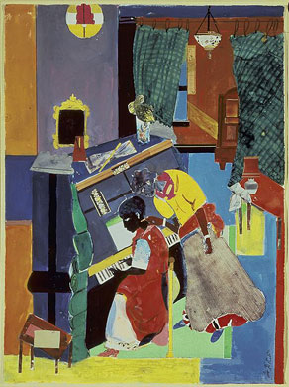
Romare Bearden
Piano Lesson
1983

Slide 14
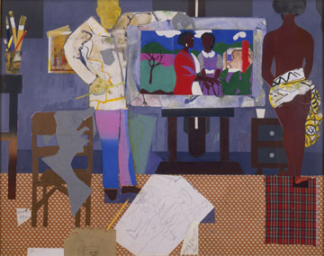

Slide 15
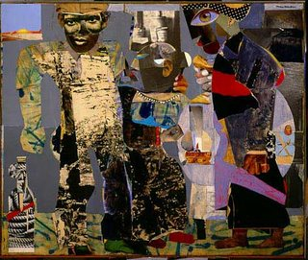

Slide 16
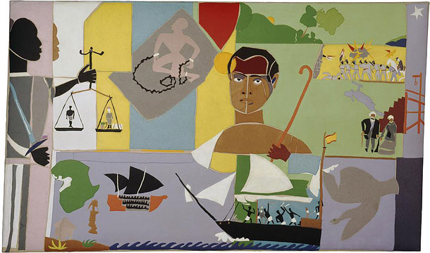

Slide 17
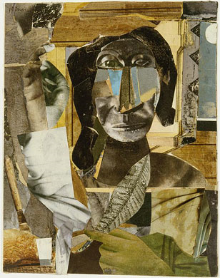
Romare Bearden
Prevalence of Ritual: Conjur Woman
1964

Slide 18
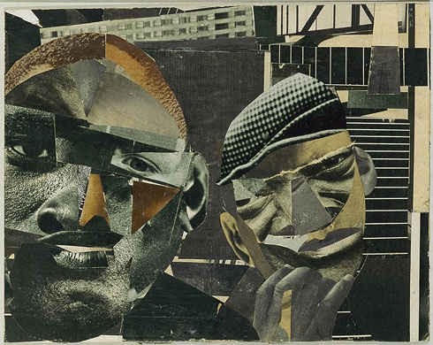
Romare Bearden
Pittsburgh Memory
1964

Slide 19
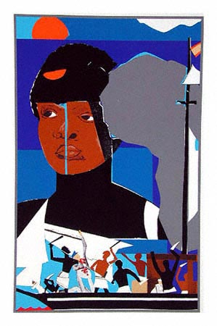

Slide 20
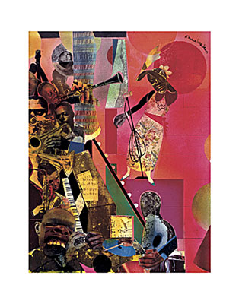

Slide 21
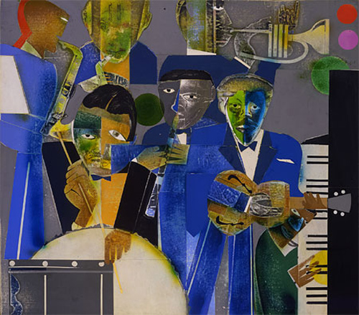

Slide 22
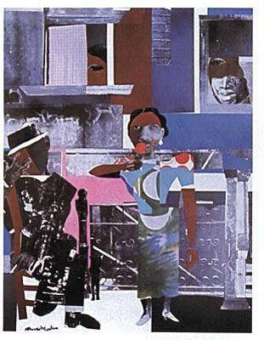

Slide 23
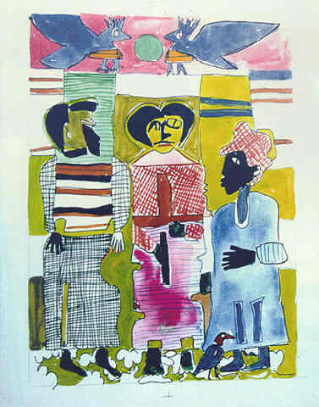

Slide 24
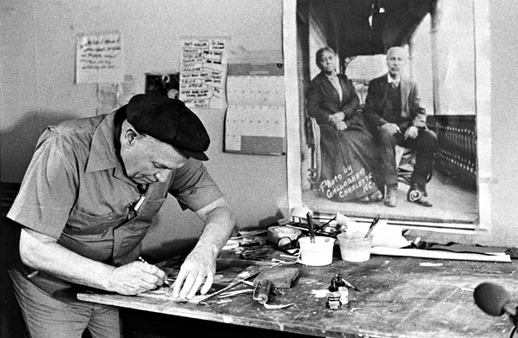

Slide 25


